Slide 1
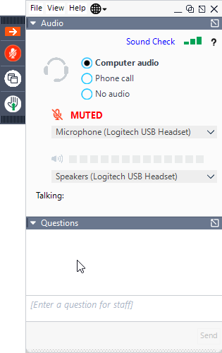
When you see this slide, you have successfully connected to our File & ServeXpress webinar. Please wait for your session to begin and our trainer to join you.
To hear the trainer, you may use the integrated audio (a headset is recommended) or use the toll-free number and access code provided when you join the webinar. Please note that an Audio Pin will be shown on the screen after you join the webinar.
If not already done, please mute your phone lines (*2 to mute/un-mute your lines). Or click the microphone button.
To expand the view of your screen, click the icon to view in Full screen mode.
To ask a question, please use the “Questions” box.
Be sure to check your dashboard for any handouts.
While you are waiting, please close all other
applications -- it helps with performance ☺.

Slide 2
Proprietary and Confidential
Wyoming Courts
EFILING TRAINING:
Chancery and District Courts
August 2023

Slide 3
Registration
How to Register eFiling Proficiency Exam
eFiling Procedures
Important Documents Court Resources Highlighted Rules, Orders, and Procedures
Electronic Filing & Service Process
Live Demonstration
Homepage Overview Case Initiation Subsequent Filing Mailbox Searches File & ServeXpress Preferences Resources
Agenda

Slide 4
Registration
Notes:
Tammy to introduce team

Slide 5
Proprietary and Confidential
Registration
Law firms and Self-Represented Litigants may register accounts at https://www.fileandservexpress.com/register/
A registration video tutorial and user guide along with other resources can be accessed at https://www.fileandservexpress.com/wyoming/
The WY Courts require all users to pass an eFiling proficiency exam prior to eFiling
It is important to register early to be sure that you have an active account and that you will not miss eService when your County goes live and to avoid “non-subscribing” accounts in the system
Attorneys must provide the exact information they provided to the Bar when registering their File & ServeXpress account

Slide 6
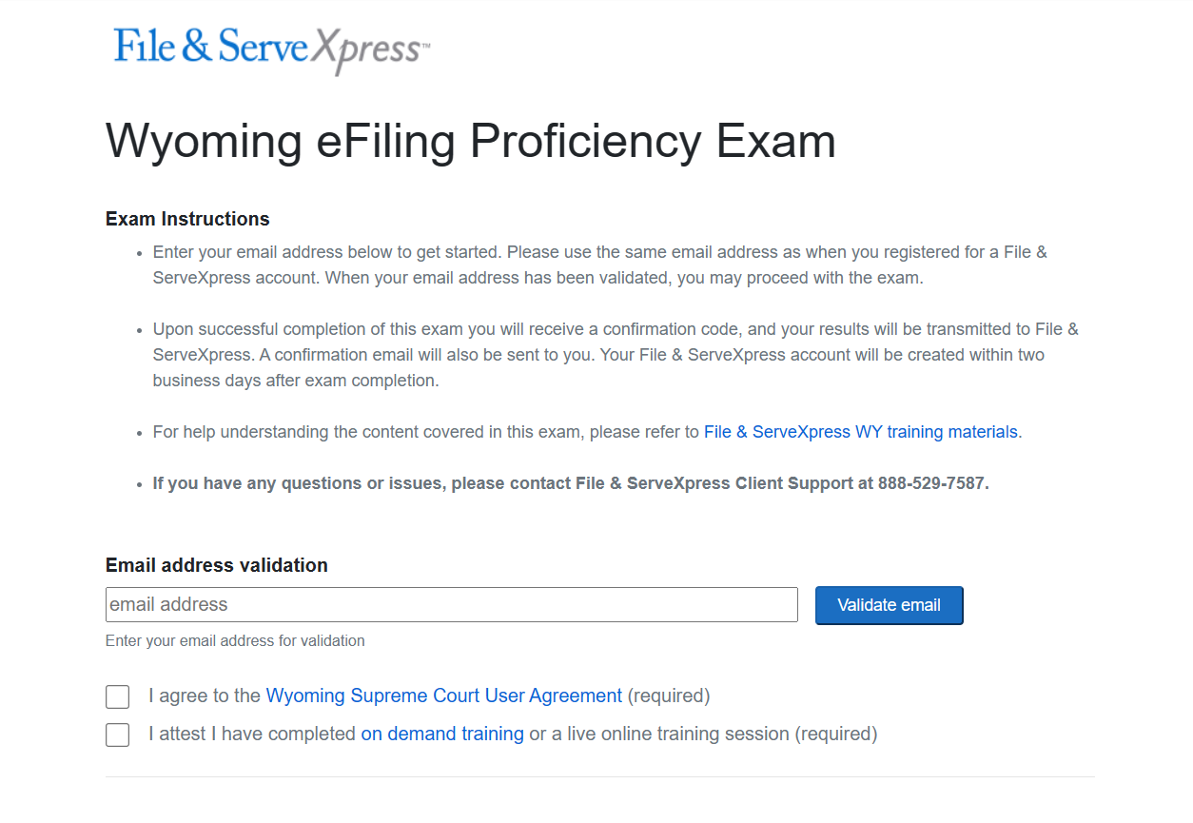

Slide 7
eFiling Procedures
Notes:
Tammy to introduce team

Slide 8
Proprietary and Confidential
Important Documents & Contact Information
Chancery Court
Prior to e-Filing, firms should review the following Documents:
eFiling Administrative Policies and Procedures Manual
W.R.C.P. for Chancery Court
Order Adopting Rules for Fees and Costs
Order Adopting Uniform Rules
Chancery Website: https://www.courts.state.wy.us/chancery-court/
For questions regarding schedules, policies, or procedures:
Chancery Email: chancery@courts.state.wy.us
Chancery Tel: 307-777-6565

Slide 9
Proprietary and Confidential
Important Documents & Contact Information
District Court
Prior to e-Filing, firms should review the following Documents:
Order Adopting the Wyoming Rules for Electronic Filing and Service in District Court
For questions regarding schedules, policies, or procedures:
District Court website: https://www.courts.state.wy.us/district-courts/district-court-locations/

Slide 10
Proprietary and Confidential
Rule, Orders, & Procedures
Applicable Rules
District Court:
Wyoming Rules for Electronic Filing and Service in District Courts
Chancery Court:
Wyoming State Chancery Filing Administrative Policies and Procedures Manual
Who may eFile?
District Court:
Wyoming licensed attorneys
Wyoming licensed attorneys’ designated staff
Chancery Court:
Wyoming licensed attorneys
Wyoming licensed attorneys’ designated staff
Self-Represented Individuals

Slide 11
Proprietary and Confidential
Rule, Orders, & Procedures
Mandatory eFiling & eService
District Court:
No
Chancery Court:
Yes
Proposed Orders
District Court:
Would like them to be filed as a supporting document to notice or motion
Chancery Court:
Must be filed as a supporting document to notice of a proposed order
Both Courts:
Editable MS Word with a blank header at least 2” from the top of the page

Slide 12
Proprietary and Confidential
Rule, Orders, & Procedures
Document Formats
District Court:
Should be converted to a text-searchable .pdf whenever feasible
Chancery Court:
Should be converted to a text-searchable .pdf, attachments or exhibits that are scanned may be filed as a standard .pdf
Both Courts:
Each pleading must be 8 ½ ″ x 11″ in its original form
Documents that are larger or smaller should be enlarged or reduced
Filers must leave a blank 3” x 3” space at the top right-hand corner of the first page of each eFiled document
Filed documents relating to a single pleading or document must be "electronically stapled" using the "main and supporting" functionality

Slide 13
Proprietary and Confidential
Rule, Orders, & Procedures
Signatures
District Court:
Digital image of handwritten signature
Signature block that includes the typed name of the individual preceded by a “/s/”
Chancery Court
Must include a conformed signature (a typed name preceded by the symbol “/s/”)
Size Limitations
10 MB per Document and 50 MB per Transaction
Documents that exceed the limitation must be broken down into smaller documents and use the “Note to Clerk” to identify the part of the document the filing represents (e.g. "Motion for Summary Judgment, part 1 of 2“)

Slide 14
Proprietary and Confidential
Rule, Orders, & Procedures
Character Limitations
FSX Case name is 200
The document title is 250 in JSI (510 in FSX)
FSX first name is 30, middle is 20 and last is 55
FSX Organization field is 100
Time of Filings
Deemed filed upon submission to FSX
Timely filed if submitted to the EFS by 11:59:59 p.m. Mountain Time
Service deemed served upon delivery of notification to online Inbox

Slide 15
Proprietary and Confidential
Rule, Orders, & Procedures
Erroneous Filings
Filings that fail to comply with eFiling rules may be removed by the Clerk within three business days of filing
These filings may be stricken from the record by the Judge
The Clerk will notify the parties if the filing is stricken or removed
Technical Failure
For relief due to a technical failure, filers must file a motion and proposed order with the court within one business day after the technical failure is resolved. Must include exhibits that substantiate the technical failure.
For documentation substantiating a technical failure, contact File & ServeXpress at 1-888-529-7587

Slide 16
Proprietary and Confidential
Rule, Orders, & Procedures
Privacy Protection
It is the responsibility of the Filer to ensure that protected personal data identifiers are omitted or redacted from documents
When the rules require a party to file both a redacted and unredacted version of a document, the user should eFile:
i. A redacted version designated as “public” in FSX;
An unredacted version designated as “sealed” in FSX
When filing a sealed document into a “Public” case, you must enter an explanation for the request for sealing the document in the note to clerk

Slide 17
Proprietary and Confidential
Helpful Hints from the Court
Available Case Categories:
Adoption
Civil
Criminal
Domestic Relations
Juvenile
Attorney should be looking in Domestic Relations for
TPR
Divorce
Custody/Visitation
Paternity
Support

Slide 18
Proprietary and Confidential
Helpful Hints from the Court
PR is now found in the Civil case class and will have a “CV” case category designation in the case number for new cases
Filers can still find and file into a case that was started as a PR
You cannot eFile Original Wills- they must be brought to the Court
County Attorneys should use the CIVIL RESTRICTED Case Class to initiate Involuntary Hospitalization cases

Slide 19
Proprietary and Confidential
Helpful Hints
The case number format must match exactly (YYYY-CC-0000000) when searching for your case
Quick Start will not update the case information, you must use the Start a Transaction Tab when the case is pulled from the CMS for the first time
If at least one attorney in the firm is representing a party on the case, all users can see all files for that case (except In Camera)
If you are filing a case with multiple defendants, you may use the Note to Clerk to designate which DEF you are filing on behalf of

Slide 20
Proprietary and Confidential
Helpful Hints from the Court
When a Document Type is labeled “Serve ONLY”, please be sure to select the “Serve Only“ option in FSX
Submit separate transactions if you are filing something and serving only something
Be sure to select the correct Document Type with the correct fee for your filing
If you select the Doc Type “Inventory & Appraisal”, you will manually add your Inventory fee prior to Submitting the filing
Depending on the County, you may see a checkbox to contribute to the Law Library Fee

Slide 21
Proprietary and Confidential
Helpful Hints
Who Receives Notifications and When
The Submitter will receive a notification in the following situations:
When they submit a transaction (transaction receipt)
When the clerk accepts a transaction (with edits) or a transaction which is an original pleading in a case
The Authorizer of the transaction will also receive a notification for #2 No notification is sent when a clerk accepts a SUBF transaction without edits

Slide 22
Proprietary and Confidential
Helpful Hints from the Court
Non-Subscribing User Accounts
If the someone initiates an update to case information and an attorney has not yet registered an FSX account, they will be added to the service list as a “non-subscribing user”
This can cause some issues including the attorney won’t be able to find the case with their Attorney account, they can’t see the documents, or they might miss electronic service
If you are experiencing any of these issues, please contact client support to ask if you have any “non-subscribing” accounts that need to be merged into your Attorney account

Slide 23
Proprietary and Confidential
Helpful Hints from the Court
OUT OF TOWN JUDGES AND SPECIAL MASTERS ON THE CASE may not have access to FSX or use it regularly if their main workflow is through different processes
Proposed orders go direct to the Judge’s FSX accounts for review, not to the clerk
Continue to copy out of town judges the way you have been where ordered
We recommend proactively sending a copy of proposed order to Special Masters or Judges on Limited Assignment cases

Slide 24
Proprietary and Confidential
Helpful Hints from the Court
HOW IMMEDIATE FSX FILINGS BECOME AVAILABLE TO THE PUBLIC (if they are not otherwise restricted):
Your filing is immediately file stamped on its way to the Public Access Terminal
The date filed will reflect a weekend/holiday date
All filings are processed into the record initially (or show on public terminal as pending filing)
All adjustments happen after initial processing. This impacts what could be available in public record/public terminal before an adjustment is made
The Public Access Terminal will be updated daily with your public filings and will include pending items that the clerk hasn’t viewed

Slide 25
Proprietary and Confidential
Helpful Hints from the Court
FSX VIEW OF DOCUMENTS IS NOT THE OFFICIAL CASE RECORD. Full Court Enterprise is the official case record relied upon by the judge, the public, and the clerk for appeals, records requests, document certification, etc.
Access to documents thru FSX view is helpful, but not official
Not all FCE corrections will translate to FSX currently
Dates in FSX are date of last processing/upload, not date of file stamp
You must open document to see official FILE DATE

Slide 26
eFiling & eService Processes
Notes:
Tammy to introduce team

Slide 27
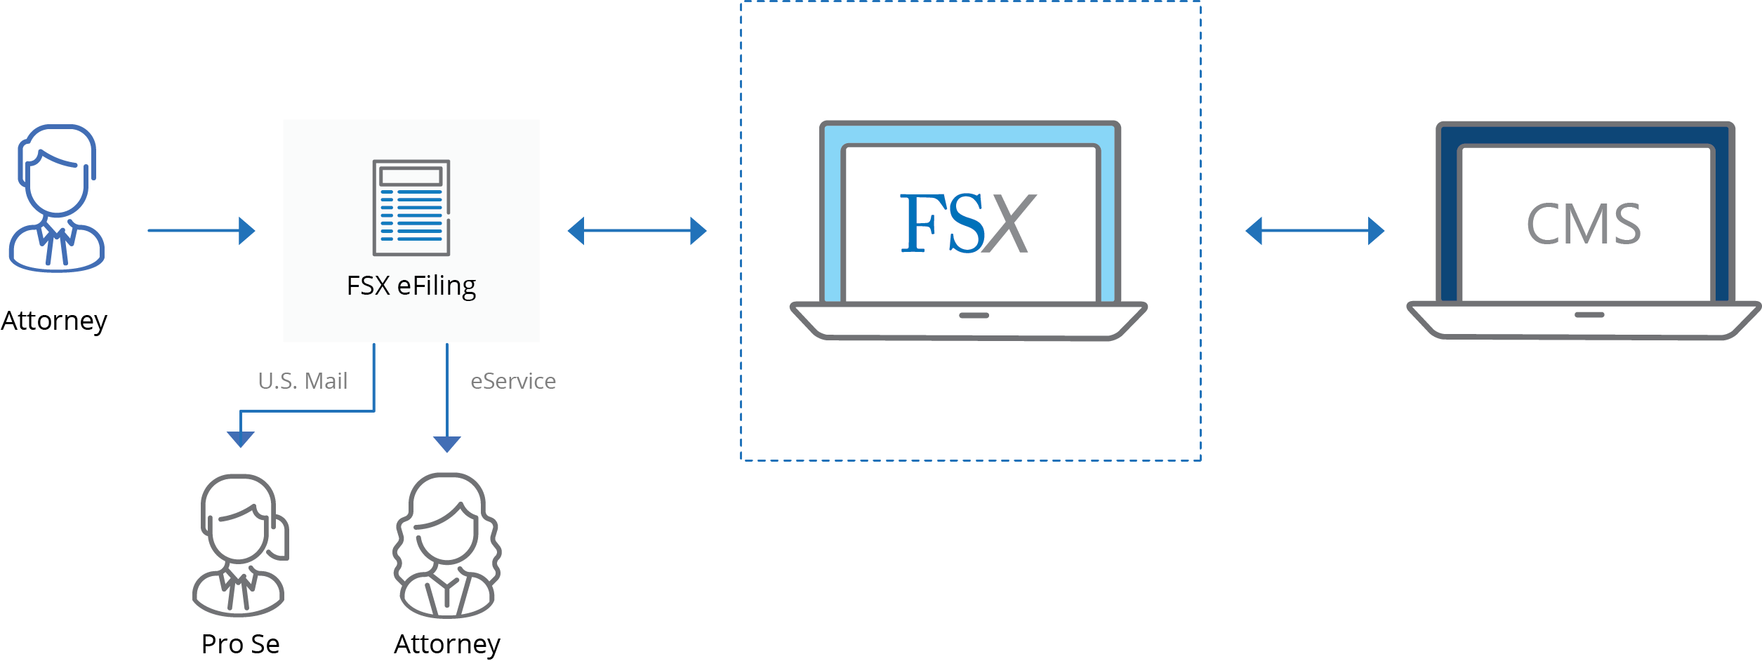
Proprietary and Confidential
Process Overview

Slide 28
Live Demonstration
Notes:
Tammy to introduce team

Slide 29
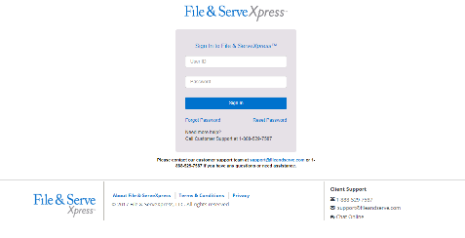
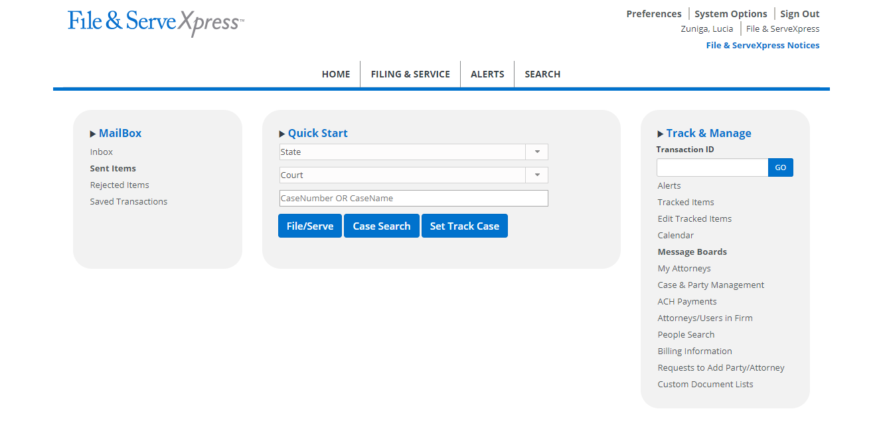
For Assistance
Client Support: support@fileandservexpress.com
888.529.7587
Resources Page: https://www.fileandservexpress.com/wyoming-resources/

Slide 30
Proprietary and Confidential
QUESTIONS

Slide 31
THANK YOU
www.FileandServeXpress.com

Slide 32
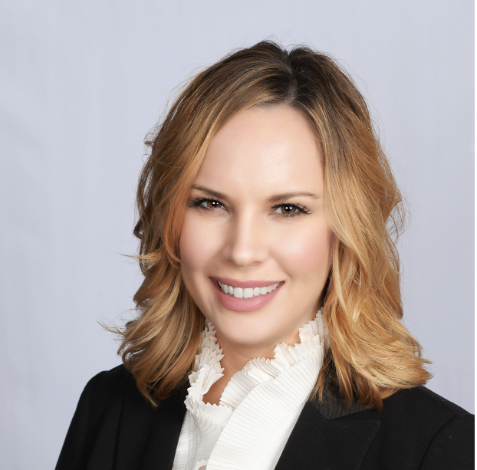
Wyoming Law Firm Support
Gina Cervino
Account Manager
gcervino@fileandserve.com
+1 972-893-6656

